Slide 1

OJ Consulting Project
Kyle Neumayer, Jessica Ellett, Mike Price

Slide 2
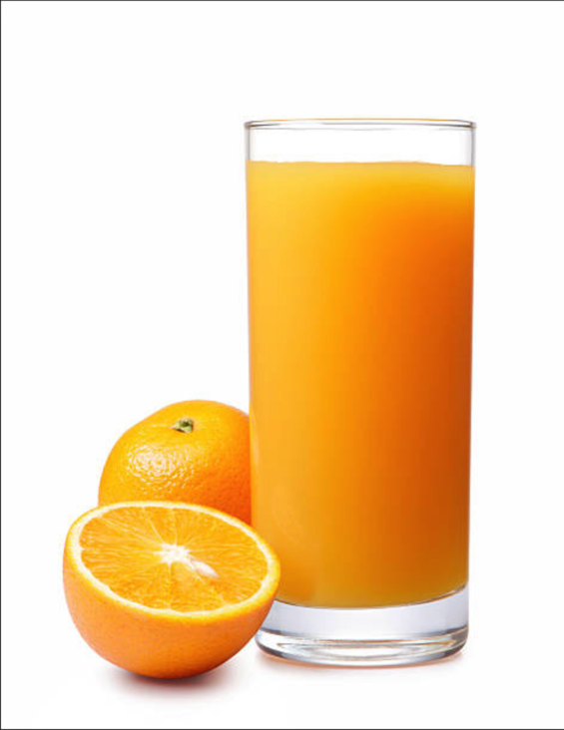
Questions Asked
Sales Manager: What is the probability of buying Minute Maid over Citrus Hill.
Brand Manager: What variables influence probability of Minute Maid OJ and what can be adjusted to maximize sales.

Slide 3
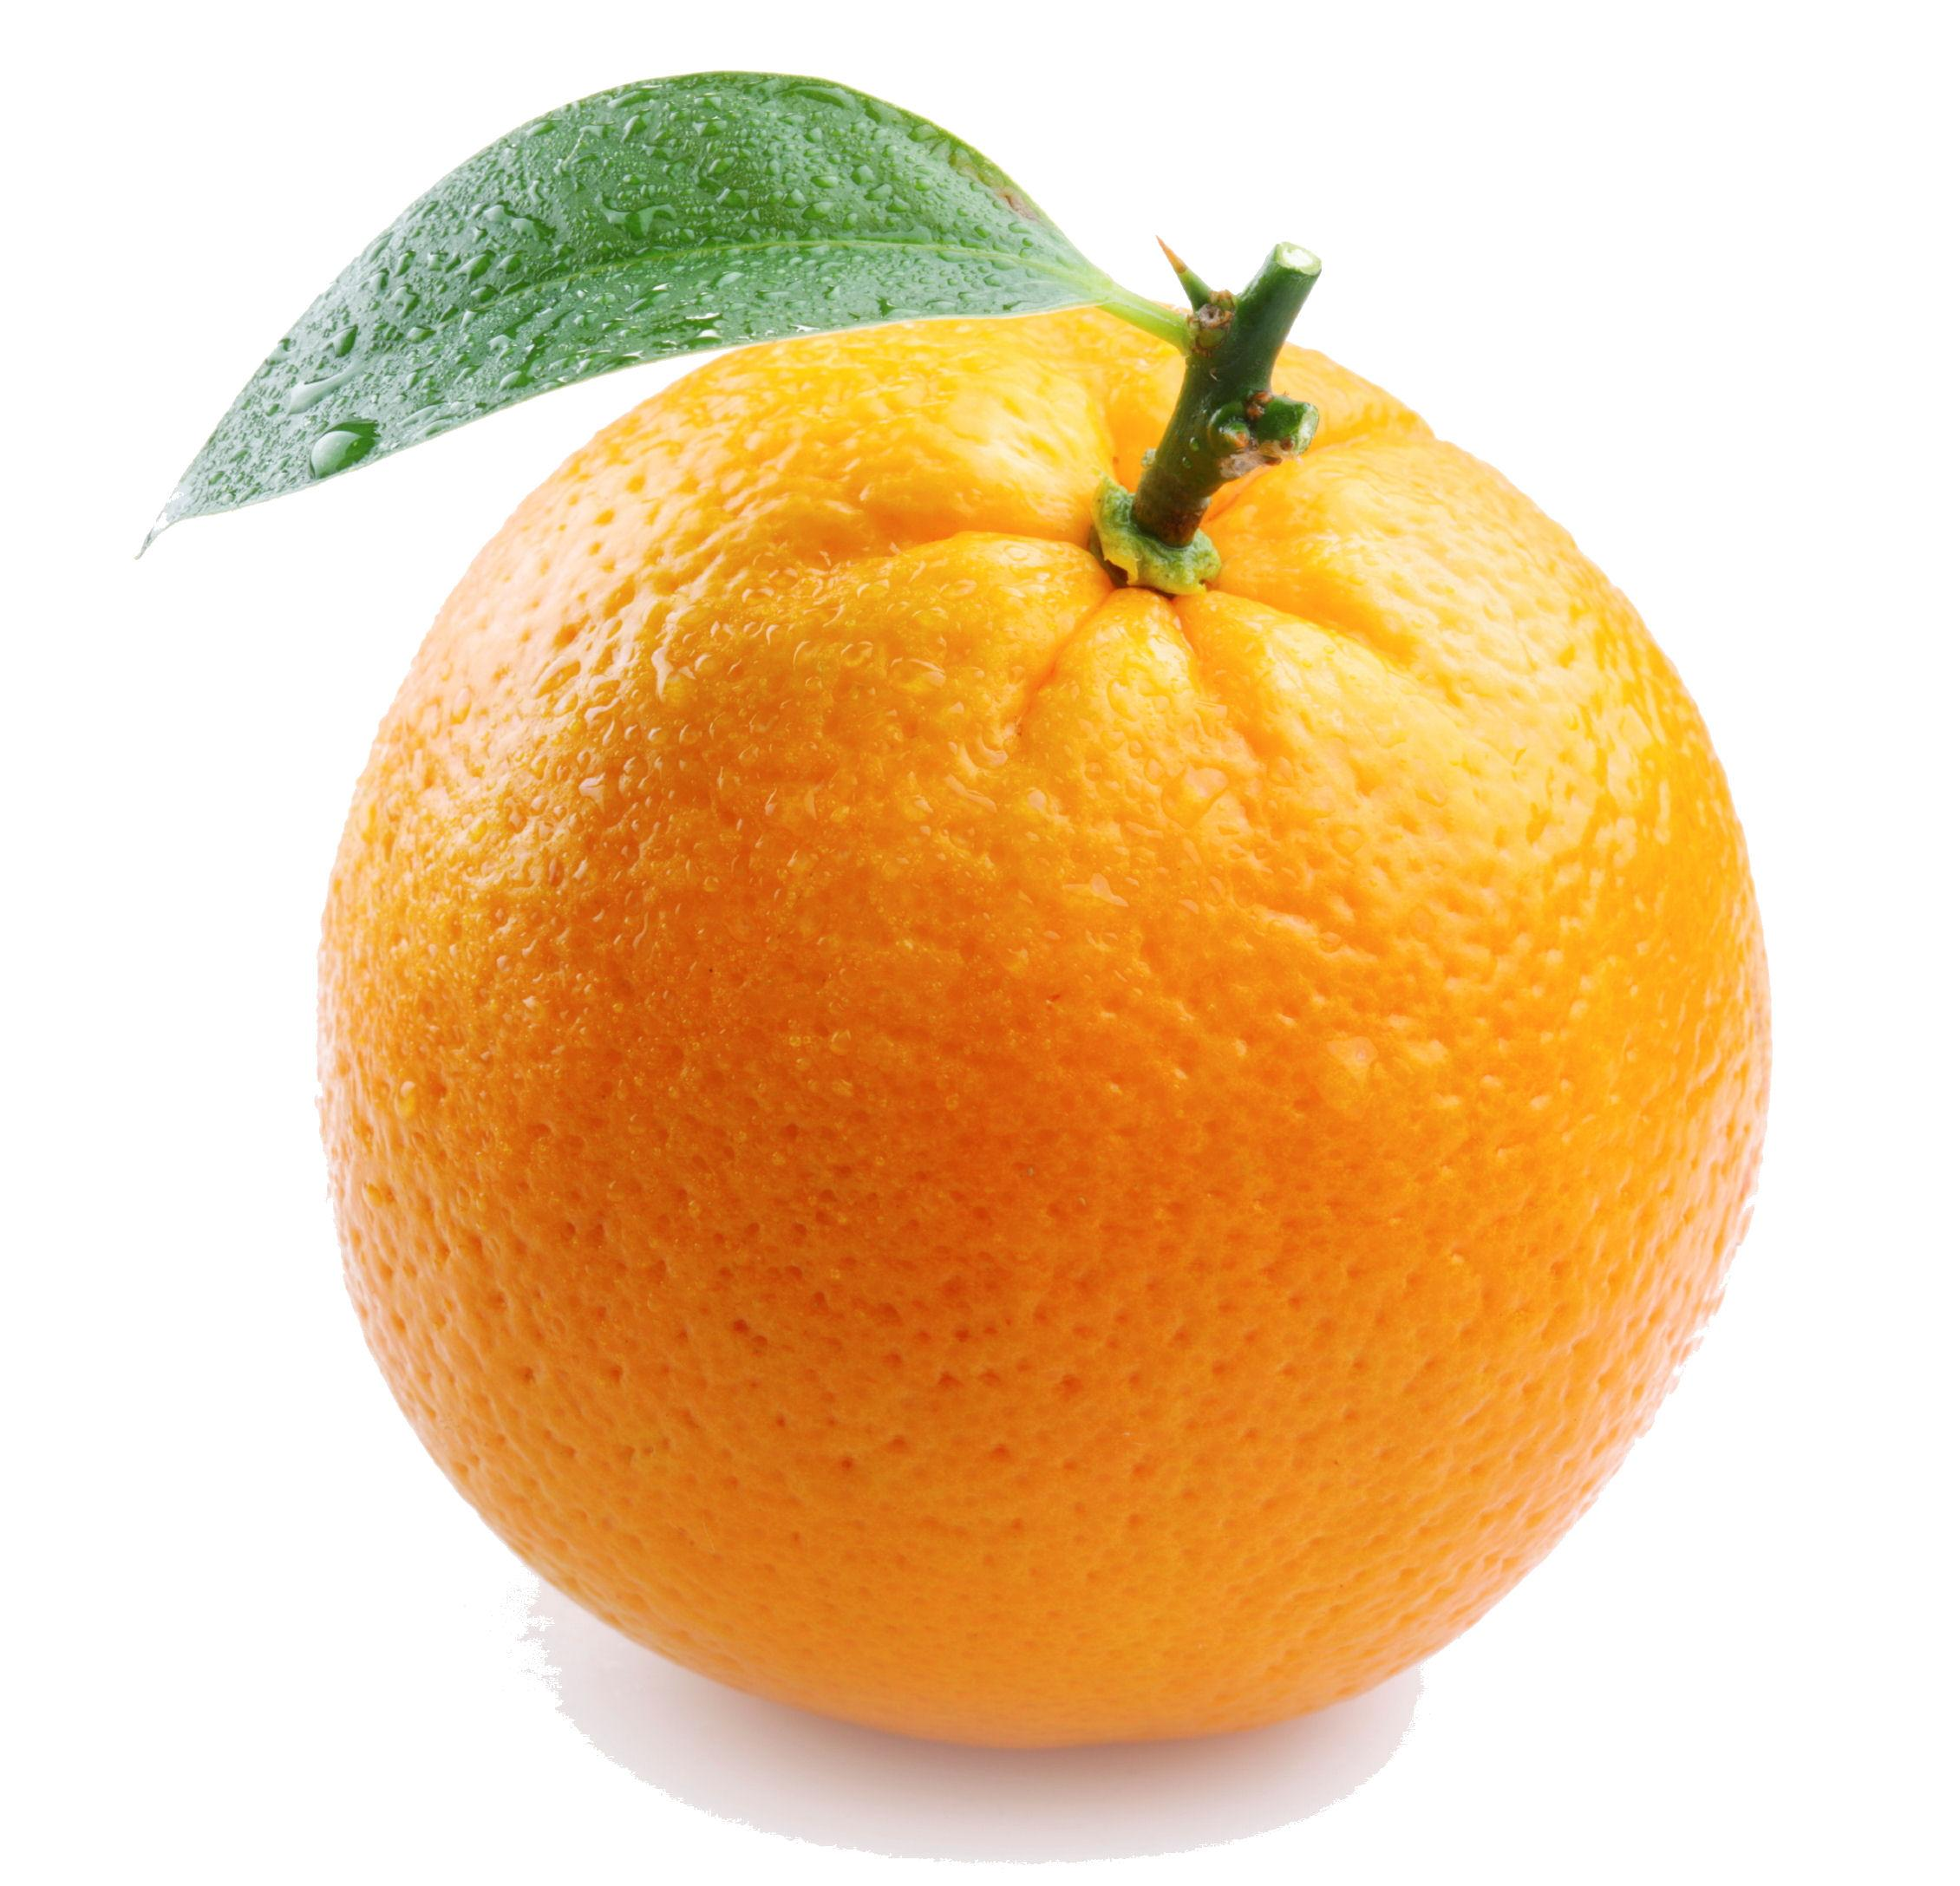
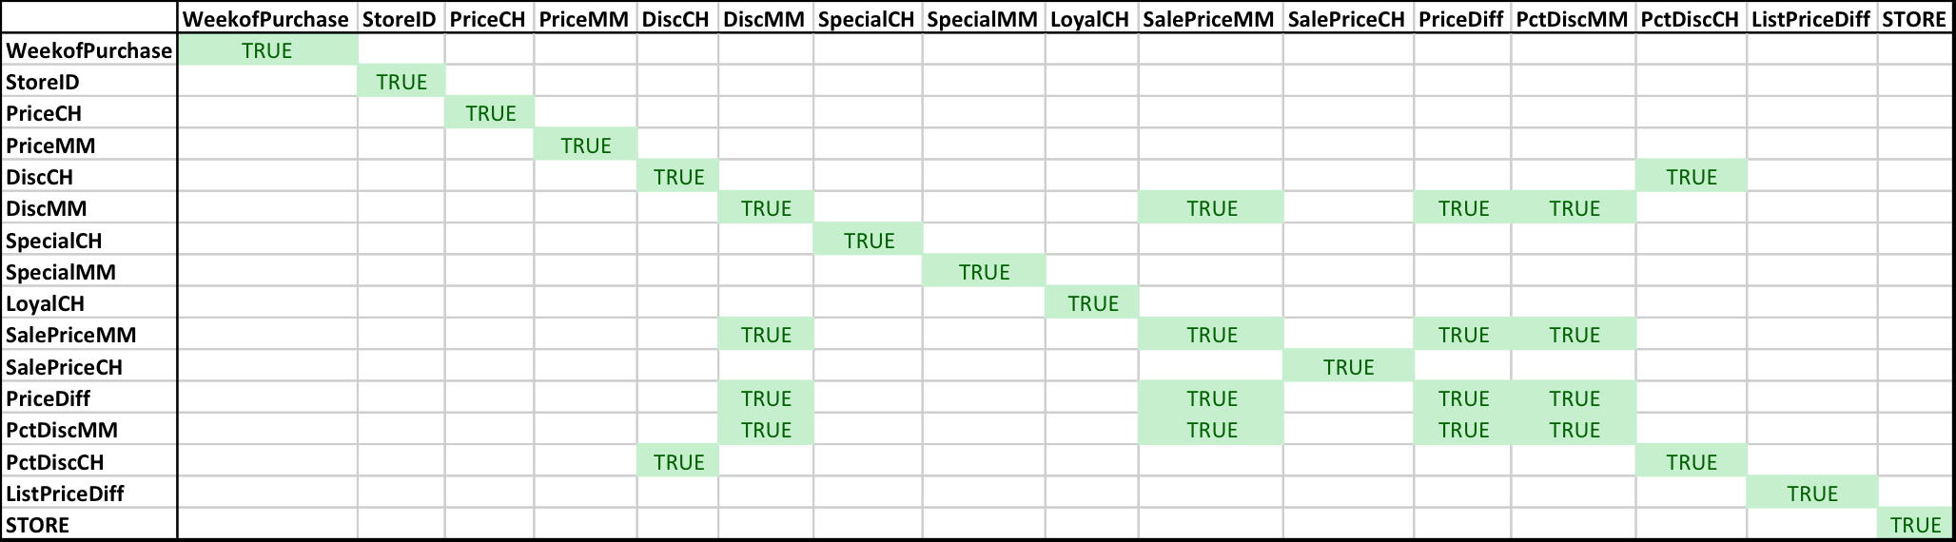
Multicollinearity
**Correlation with 85% cutoff

Slide 4

Variable Selection
Intuition
Multicollinearity matrix
Standardizing the variable effect
Evaluating coefficients and p-values in logistic model
Notes:
PriceCH, PriceMM, LoyalCH, PctDiscMM, PctDiscCH

Slide 5

Logistic Method
We chose this method for the brand manager for several reasons:
Response is Binary
It’s accuracy isn’t much behind that of SVM
We can convert our model in terms of probability
We have coefficients that when combined with observations can provide estimates for individual customers
Ability to interpret significance and magnitude of impact for each variable

Slide 6
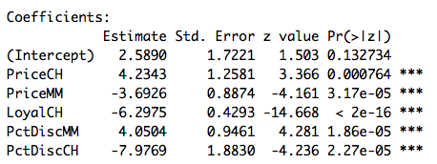

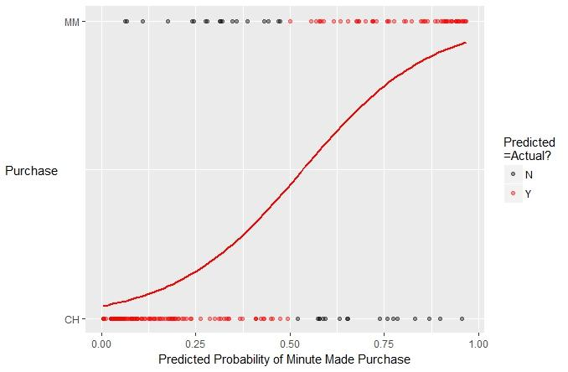
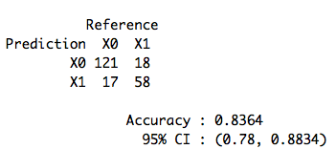
Model output and performance

Slide 7

SVM Model
We chose this model for the sales manager for several reasons:
Slightly better accuracy in a prediction
No need for insights into variable magnitude or direction of impact
Predicts probability, which is a continuous variable outcome
svmLinear performed better than a polynomial or RBF model
Standardized variables

Slide 8
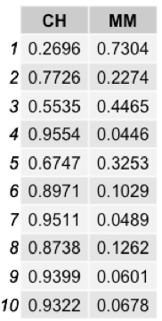
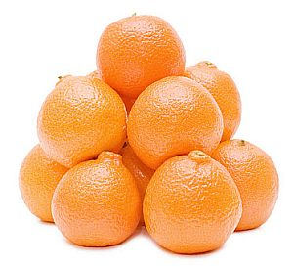
SVM model output and performance
“What is the probability consumers will purchase Minute Maid?”
37% purchase MM, 63% purchase CH
We are 95% confident that our model will accurately predict the Purchase on 79-89% of all orange juice purchases in the grocery store, as shown in the confusion matrix output below.
Confusion Matrix and Statistics
Reference
Prediction X0 X1
X0 122 18
X1 16 58
Accuracy : 0.8411
95% CI : (0.7851, 0.8874)
No Information Rate : 0.6449
P-Value [Acc > NIR] : 1.431e-10

Slide 9
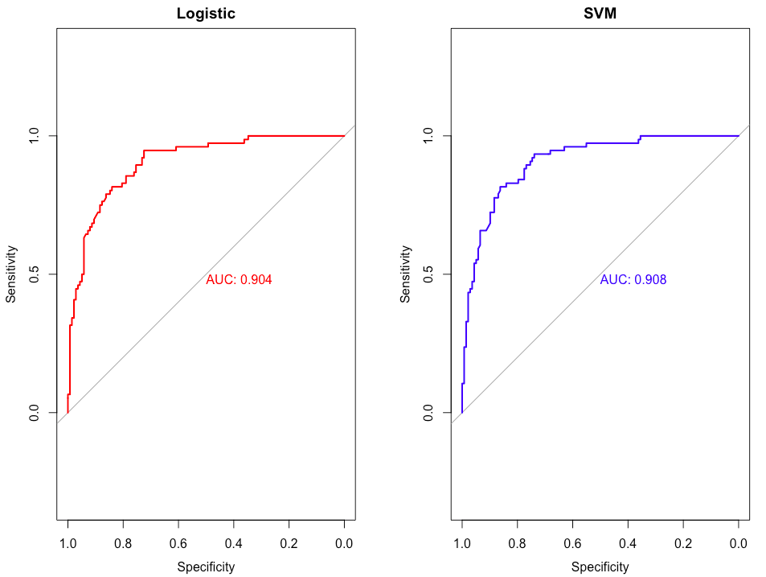

ROC Curves

Slide 10
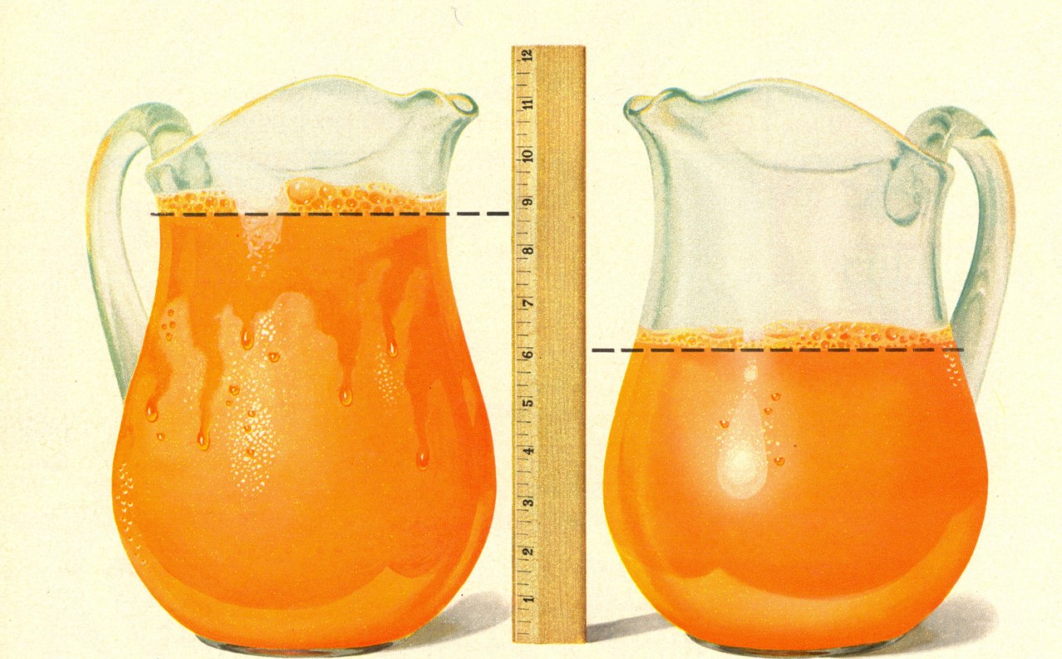
Results and Conclusions
On the basis of the 5 variables used for the Regression model and SVM we would like to recommend following points to the managers:
Brand Manager
Increase price of Citrus Hill to attract more Minute Maid customers and build MM customer loyalty.
The discount on the CH is most sensitive variable among all. So, if there is an increase in discount of CH then there should be either increase in the price of CH or increase in the discount of MM to compensate the impact of PctDiscCH.

Slide 11
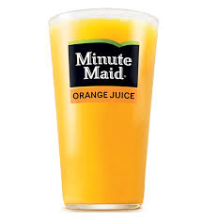

Keeping the price of MM low will also accumulate the probability of purchasing MM.
Customer loyalty for CH can not be sell or discounted but still it should be in consideration as it is also a significant variable. Managers can execute one of the strategy to keep it minimal.
Note: price increase on CH has greater impact on sales of MM than discount on MM.
Sales Manager
Model can predict purchase of MM vs. CH. Recommend reevaluating the model and its accuracy on a consistent basis.

Slide 12
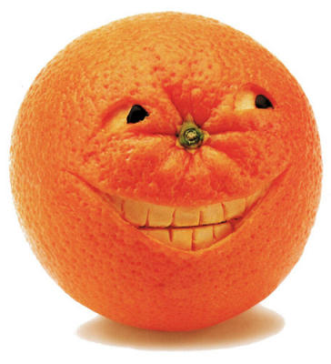
Thank You

